Slide 1
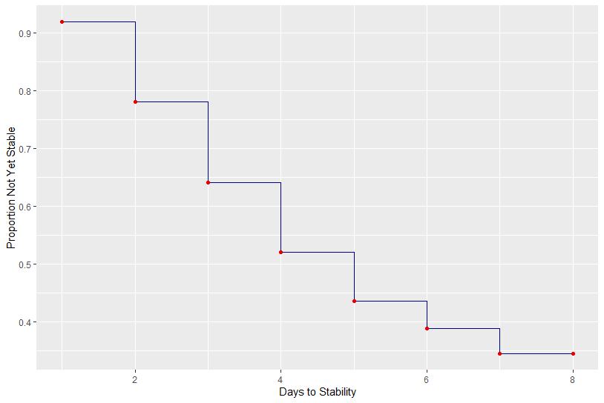
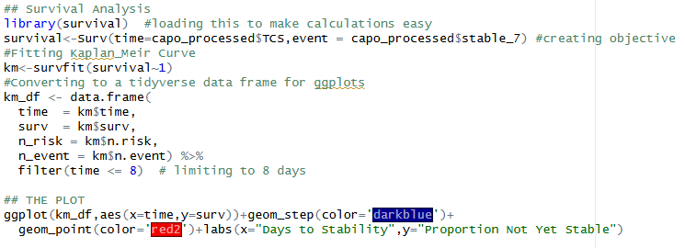
Survival Analysis Curve
Survival Analysis Curve

Slide 2


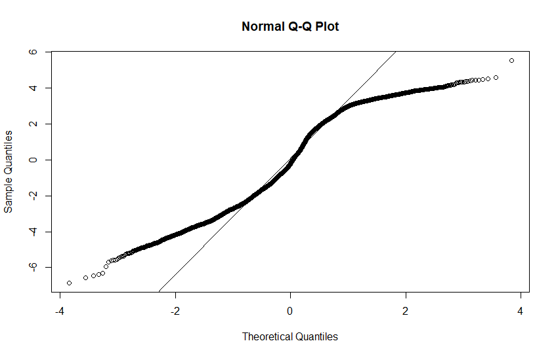
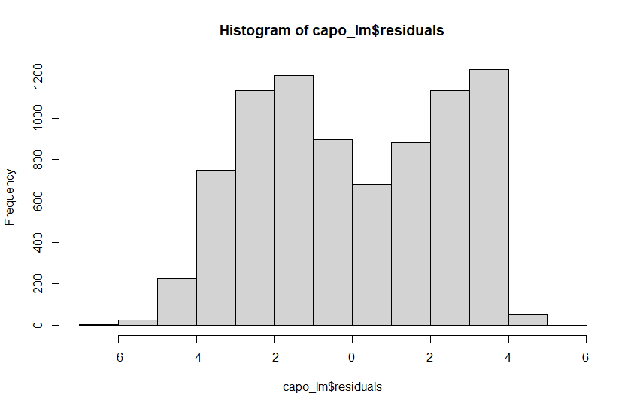
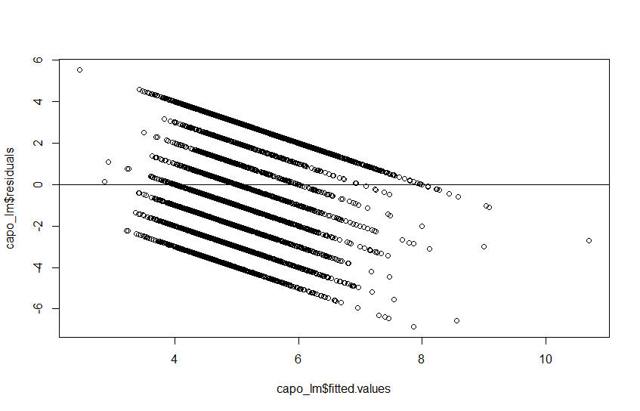
Creating the Linear Model and Checking the Residuals

Slide 3
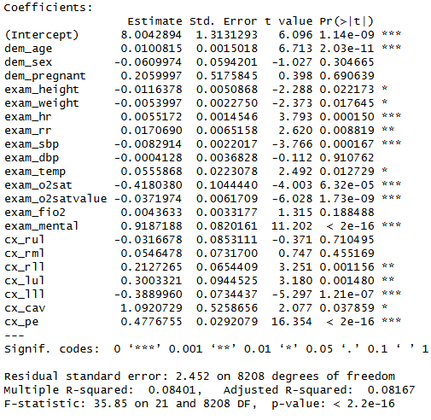
Summary of Linear Model

Slide 4

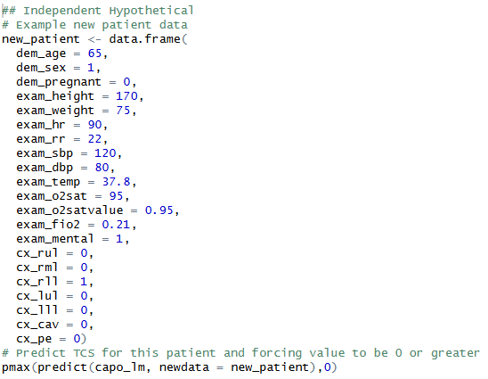
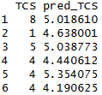
Methods For Prediction

Slide 5
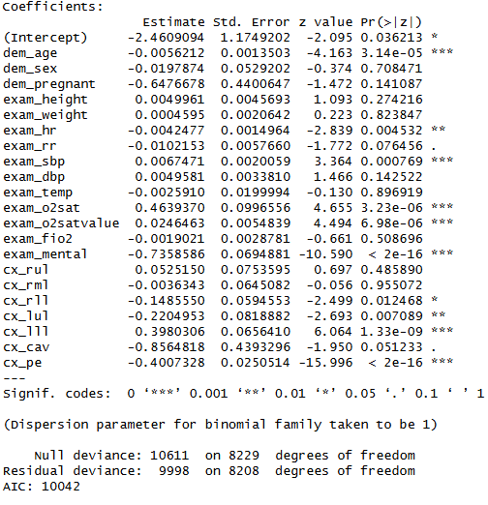

Logistic Model For Stable
0.6917375

Slide 6
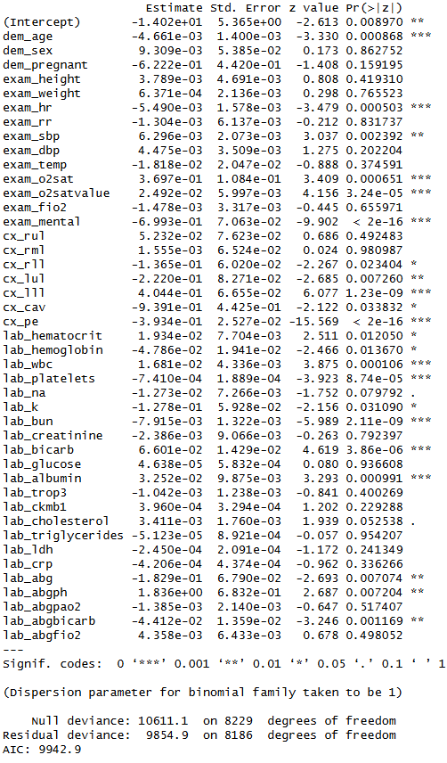


Logistic Model For Stable Using “Lab” Columns
0.6973269

Slide 7
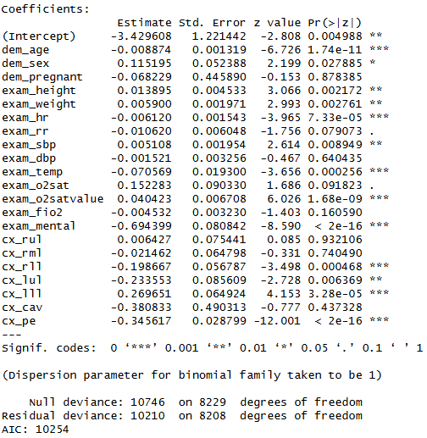

Logistic Model For Early TCS
0.6538275

Slide 8
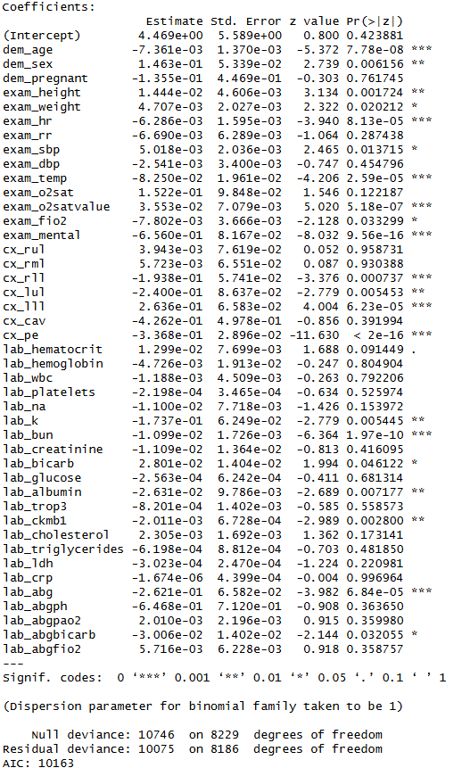

Logistic Model For Early TCS using “Lab” Columns
0.6624544

